Slide 1

BRIGHTCART Website PERFOMANCE Analytics
Website Performance and Marketing ROI Analysis
Presented by: LOVETH ILEN
Tools Used: Microsoft Excel | Data Analysis | Dashboard Visualization
Date: 8/3/2026

Slide 2
BUSINESS OVERVIEW
The company operates an online platform that depends on website traffic from different digital channels such as Organic Search, Direct visits, Social Media, Referrals, and Paid Advertising.
Every visitor that lands on the website represents a potential customer. Because of this, the company invests time and marketing resources into attracting users and encouraging them to explore the site and complete purchases.
For this project, I wanted to understand how well the website is performing. Specifically, I analyzed where visitors are coming from, when they are most active, and which factors influence whether they convert into customers.
By understanding these patterns, the company can make smarter marketing decisions and improve the return on its marketing efforts.

Slide 3
THE BUSINESS CHALLENGE
THE OBJECTIVE
While the website attracts a good number of visitors, the company does not have a clear picture of which channels and user behaviors are actually driving conversions.
Some key questions needed to be answered:
Which traffic sources bring the most valuable visitors?
When are users most active on the website?
Which devices lead to the highest conversions?
Which locations generate the best results?
Are there any marketing channels that are underperforming?
Without this information, marketing budgets may not be used in the most effective way.
In this project, my goal was to use data analysis to move from guessing to understanding how the website performs.
I focused on:
Identifying peak traffic hours and engagement periods
Understanding which traffic sources bring the most conversions
Analyzing user behavior across devices and locations
Discovering patterns in when and how users complete purchases
Providing recommendations that can help the company improve marketing ROI and overall website performance

Slide 4
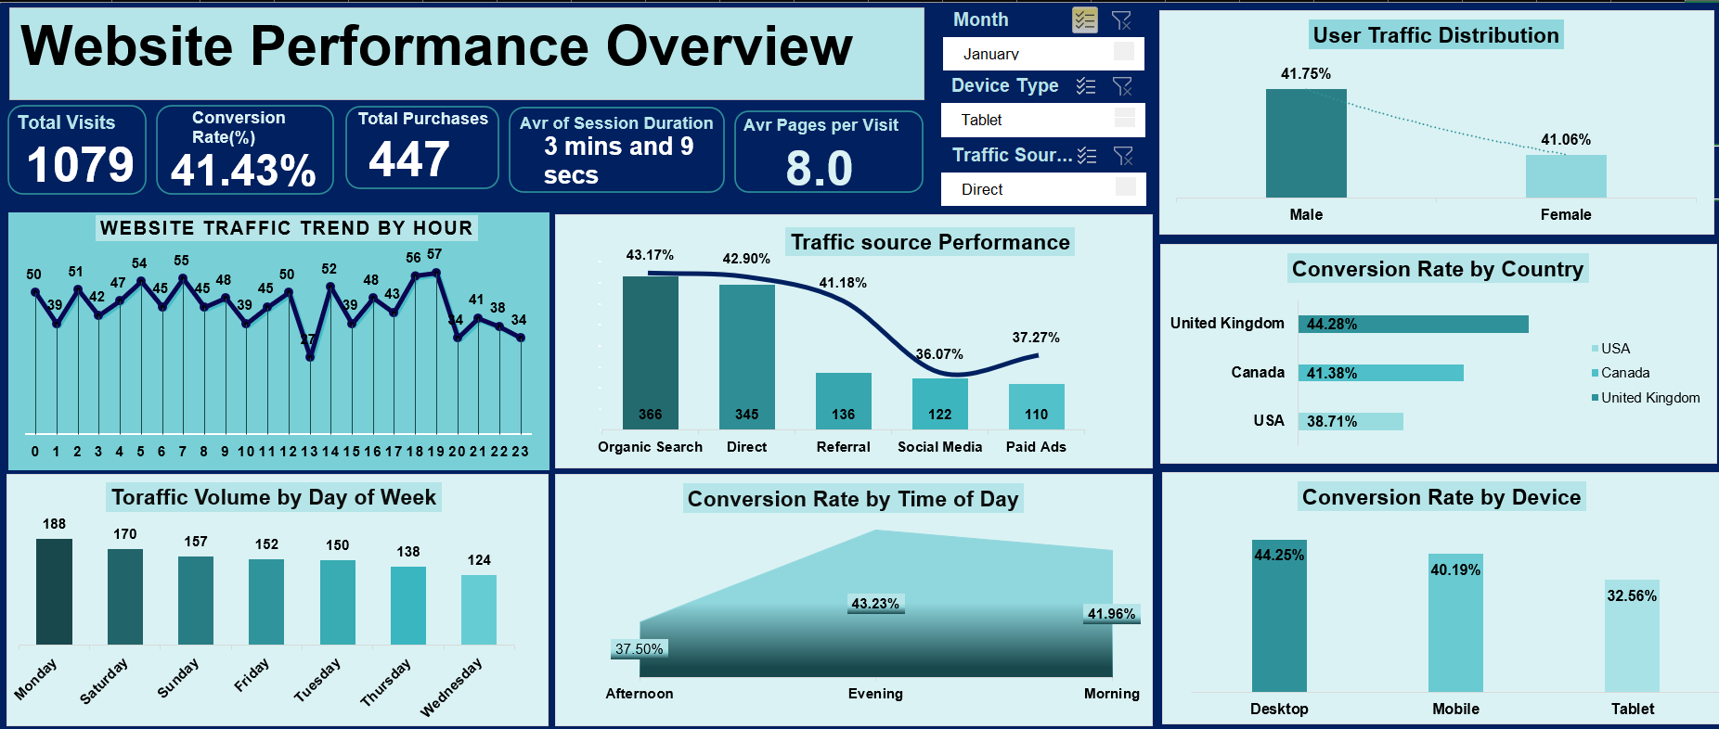
This dashboard provides a complete view of website traffic performance, conversion behavior, and user engagement across multiple dimensions including traffic source, time, device, and geographic location.

Slide 5
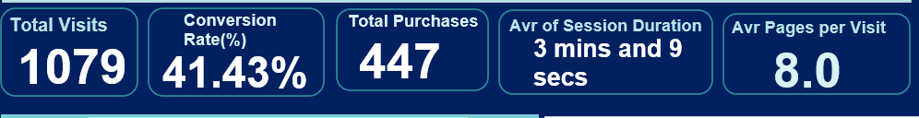
WEBSITE KPI PERFORMANCE
Analysis
The website recorded 1,079 total visits, which resulted in 447 purchases. This gives us a conversion rate of about 41%, which is quite strong.
On average, users spend 3 minutes and 9 seconds on the site and visit around 8 pages during a session.
Strategic Insight
These numbers suggest that visitors are not just landing on the website and leaving. Instead, they are exploring multiple pages before making a purchase, which indicates strong engagement.
Recommendation
The company should continue improving the website’s navigation and product discovery experience so visitors can easily explore more pages and complete purchases.

Slide 6
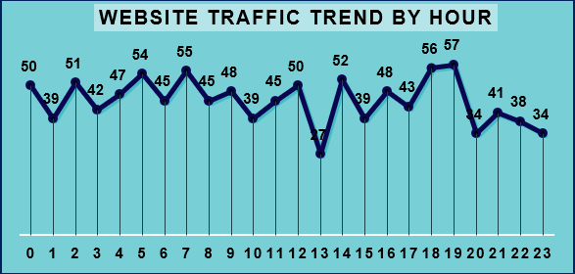
Analysis
Website traffic changes throughout the day, with some hours showing higher activity than others. There are noticeable spikes during certain morning and evening periods.
Strategic Insight
These peaks represent the times when users are most active and likely browsing the website.
Recommendation
Marketing campaigns such as promotional emails, ads, or social media posts should be scheduled during these peak hours to reach the largest number of active users.

Slide 7
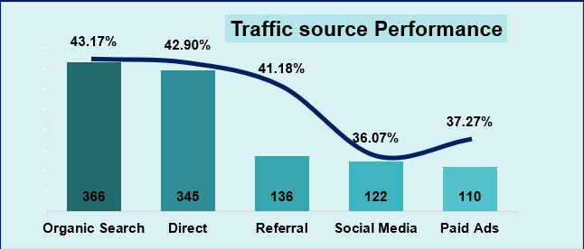
Analysis
Organic Search and Direct traffic bring in the highest number of visitors to the website. These channels also show relatively strong conversion performance.
Social Media and Paid Ads contribute traffic as well, but their conversion impact appears lower compared to the other channels.
Strategic Insight
Organic traffic is especially valuable because it brings users who are actively searching for relevant content or products.
Recommendation
The company should continue strengthening its SEO strategy while reviewing the targeting and messaging used in paid ads and social media campaigns.

Slide 8
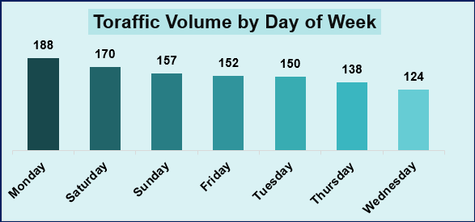
Analysis
Website traffic varies depending on the day of the week. The data shows higher traffic levels on Monday and Saturday, while mid-week days tend to be slightly quieter.
Strategic Insight
This suggests that users are more likely to browse the website at the start of the week and again during the weekend.
Recommendation
Marketing campaigns and promotions should be scheduled around these higher-traffic days to increase visibility and engagement.

Slide 9
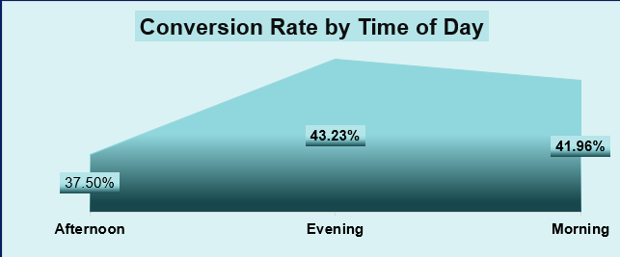
Analysis
The data shows that evening hours have the highest conversion rate, slightly higher than morning and afternoon periods.
Strategic Insight
This likely reflects typical user behavior. Many people browse casually during the day but make purchasing decisions later in the evening when they have more free time.
Recommendation
Promotional campaigns and limited-time offers could be launched during the evening to capture users when they are most ready to convert.

Slide 10
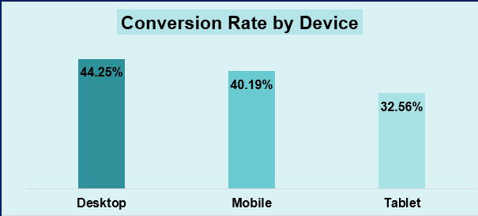
Analysis
Desktop users have the highest conversion rate, followed by mobile users. Tablet users show the lowest conversion performance.
Strategic Insight
This suggests that the purchasing experience may be smoother on desktop devices compared to smaller screens.
Recommendation
Improving the tablet and mobile user experience could help increase conversions from these devices.

Slide 11
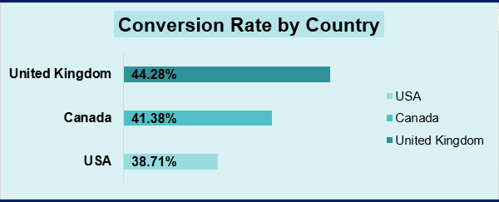
Analysis
The United Kingdom shows the highest conversion rate, followed by Canada, while the United States has slightly lower conversion performance.
Strategic Insight
This indicates that users from the UK and Canada are particularly responsive to the website’s products or marketing campaigns.
Recommendation
The company should consider increasing marketing efforts in these high-performing regions while reviewing potential barriers affecting conversions in the US market.

Slide 12
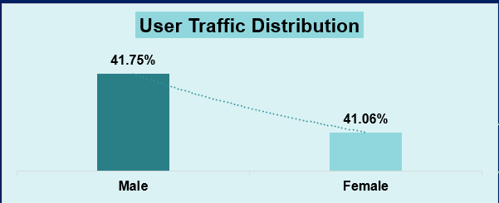
Analysis
The gender distribution of website visitors is fairly balanced, with slightly more male visitors than female visitors.
Strategic Insight
This suggests that the website appeals to a broad audience rather than a very specific demographic.
Recommendation
Marketing campaigns can remain broadly targeted, but further segmentation may help uncover opportunities for more personalized marketing.

Slide 13
DETAILED FINAL RECOMMENDATIONS
Based on the analysis, several key actions could help improve website performance:
Focus more on high-performing traffic sources such as Organic Search and Direct visits.
Optimize marketing campaigns to align with peak traffic hours.
Improve the website experience for mobile and tablet users.
Increase marketing efforts in high-converting regions like the United Kingdom and Canada.
Revisit paid advertising strategies to improve targeting and conversion efficiency.

Slide 14
FINAL THOUGHTS
After analyzing the website data, it’s clear that the company already has strong engagement from its visitors.
Users are spending time on the site and exploring multiple pages before converting.
However, there are still opportunities to improve how marketing resources are allocated. By focusing on high-performing channels, optimizing campaign timing, and improving user experience across devices, the company can increase conversions and get better value from its marketing investments.
The dashboard created in this project allows decision-makers to quickly monitor these trends and make smarter, data-driven decisions.

Slide 15
THANK YOU

